Slide 1
Typescript Fundamental

Slide 2
In this section…..
Type Annotations
Arrow Function
Interfaces
Cohesion/Classes
Inheritances
Object
Polymorphism
Constructor
Access Modifier
Fields, Properties
Modules

Slide 3
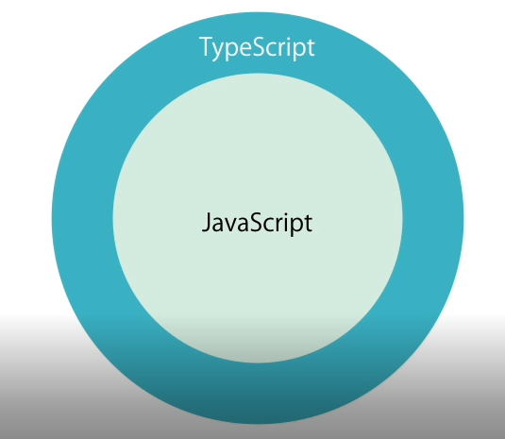
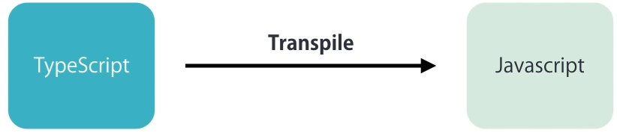
What is Typescript ?
A programming language
Free and open source
Developed and maintained by Microsoft
Superset of JavaScript
Strong Typing, Object Oriented Feature, Compile-time errors, Great tooling

Slide 4
Why Typescript ?

Slide 5
Your First Typescript Program
Declaring Variable (var,let)
Enum
Types
Types Assertion
Arrow Function

Slide 6
Interfaces Pascal naming

Slide 7
Cohesion/Classes
When a function inside class its called method

Slide 8
Inheritance

Slide 9
Polymorphism
Duck typing

Slide 10
Constructor
Reserved keyword
C# has multiple constructor, but TS have not.
So we make parameter optional

Slide 11
Access Modifier, Property, Fields
constructor(private _x?:number){
}
get x(){
return this._x;
}
Property is actually looks like field form outside, but internally its method like get set.

Slide 12
Generic Type
function do<T>(data:T):T{
}
function test(data:any):any{
}
var data:string=test(1);

Slide 13
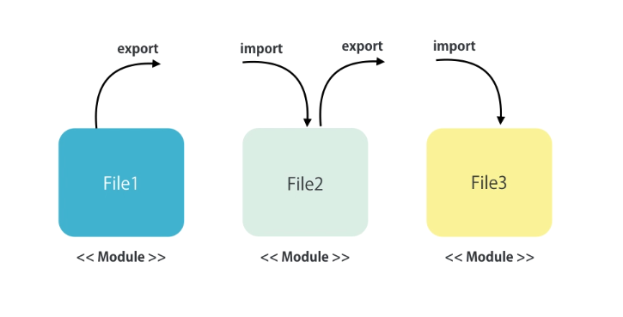
Module

Slide 14
Next….
Angular Fundamental
ECAP3 Project Structure
DB Configuration
Angular Style Guide (single responsibility, small function, naming, file name)

Slide 15
Home Work
Github Api
Business implement in Service
Get data via Service
Creating an api request Serviece
Use external library like lodash/request

